Slide 1
ABBBBBBBBBBBBBBBBBBBBBBBCCCCCCCCCCCCCCCCCCCCCCCCCCCCCCCCCCCCCCCCCCCCCCCCCCCCCCCCCCCCC
Course Title
Technical Session – 16th January 2025
Guest Speaker:
Samantha MUSOKE
www.icanlagosanddistrict.org

Slide 2
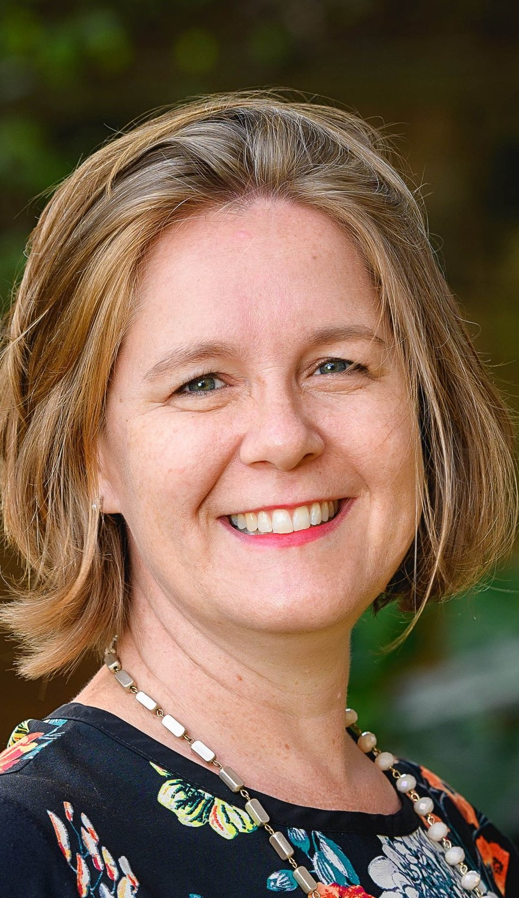
Samantha Musoke, MA Hons Cantab, ACA, CPA
Samantha MUSOKE is a passionate UK Chartered Accountant (ACA) with 20+ years post qualification experience in the non-profit sector in Uganda, as auditor, consultant, trainer, advisor, CFO and Board member. Previous roles include auditing with Mazars and Carr Stanyer Sims; training delivery, training of trainers and training design with Humentum (formerly Mango); financial consultancy with Aclaim Africa Ltd for a variety of NPO clients across Africa and UK, Grant Management Advisor for VSO Uganda, CFO for Child’s i Foundation, Board Treasurer of two schools and Regional Director East Africa for Humentum.
Sam is the Uganda Contact Member for the Institute of Chartered Accountants for England and Wales (ICAEW), and active on LinkedIn. Sam has a degree in Natural Sciences (Zoology) from Cambridge University, where she was also Organ Scholar for Christ’s College. She lives in Kampala with her husband and three children.

Slide 3
INPAS The future of financial reporting for non-profit organisations www.ifr4npo.org
Assets
Liabilities
Reserves
Income
Expenditure
Surplus

Slide 4
Completing the suite
IFRS (Corporates)
International Financial Reporting Standards and IFRS for SMEs
IPSAS (Governments)
International Public Sector Accounting Standards
INPAS (Non-Profits)
International Non-Profit Accounting Standard
Since 1973
Since 1997
From 2025

Slide 5
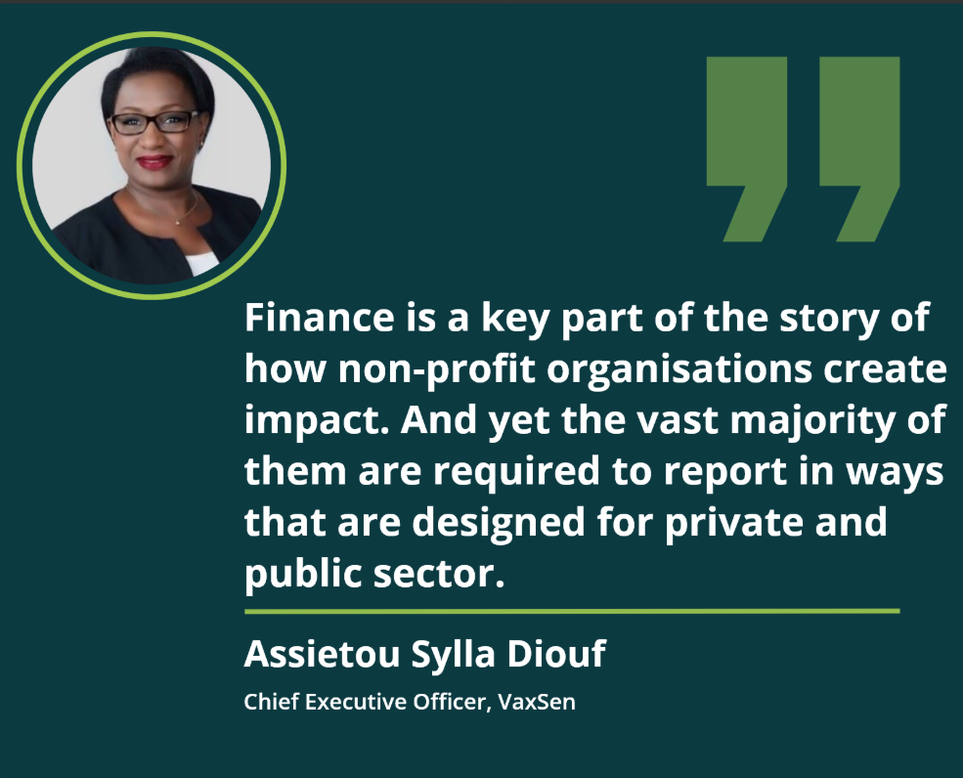

Slide 6
NPOs need their own standard
Common features
Missional impact > profit, ROI or EPS
Focus on accountability, compliance and sustainability
No distributions to private owners
Income from grants and donations
Use and time restrictions on income
Donated goods & services / volunteers
Assets that serve mission rather than generating revenue
Special-purpose financial reporting for donors

Slide 7
Notes:
I love this image of NPOs churning out reports for different users, in different ways at different times, and sometimes in ways that conflict or contradict each other.

Slide 8
The Problem:
92% countries have no relevant NPO standard. Multiple financial reporting formats, burden, inefficiency, inequity and low trust throughout the ecosystem
Funders
Inconsistent formats, needs not met
Regulators / Society
Lack of information & transparency
NPOs
Burden of multiple reporting formats
Auditors
No appropriate framework to reference
Problems for
Root cause
No internationally applicable accounting standard

Slide 9
Theory of change
Equity
Resilience
Accountability
Creation and adoption of an internationally applicable accounting standard for NPOs will create an environment where NPOs have more equitable access to income and financial health.
INPAS
International Non-profit Accounting Standard
Country adoption decisions
Funder endorsement and adoption
Future
Improved usefulness, transparency and consistency of NPO financial reports
NPOs able to demonstrate capacity and attract funds, reducing duplication of effort
Funders better able to reliably assess NPOs
Simplified audit assurance provision
Global Community – network of NPO stakeholders

Slide 10
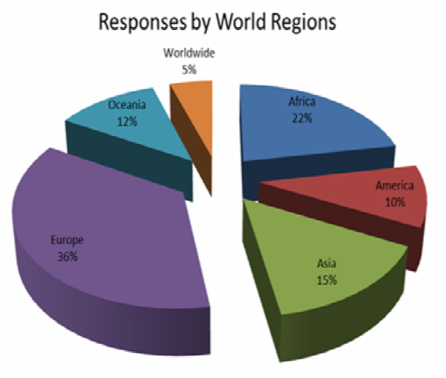
2014 Evidence of demand
2014 academic study (CCAB Survey) funded by the UK Professional Accountancy Organisations of international financial reporting for the NPO sector
605 responses - 179 countries
72% ‘agreed’ or ‘strongly agreed’ an ‘international standard’ for NPOs would be useful
Notes:
Academic research highlights the need and demand for a standard.

Slide 12
Who is developing INPAS?
A global nonprofit building and supporting operating models that create equity, resilience, and accountability in the global development sector.
Chartered Institute of Public Finance and Accountancy
Unique standard setter roles for local government and charities in UK
Stakeholder engagement
Technical rigour
Both NPOs: “By the sector, for the sector”

Slide 13
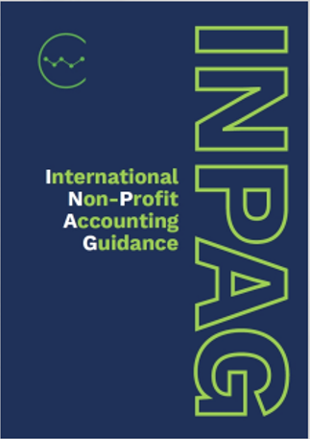
Guidance development model
Section status | Description
Modified | Fully updated to reflect NPO requirements.
Editorial | Updated to align with modified Sections, but not in itself fully reviewed
Unchanged | Updated for terminology changes only
New | Developed specifically for NPOs.
Removed | Not relevant to NPOs
IFRS for SMEs Accounting Standard (36 sections)
Under license agreements from IFRS Foundation and IFAC
IFRS, IPSAS & National standards

Slide 14
How is INPAS being developed?
Multi-year initiative, to secure international buy-in
2019 project launch - 2025 publishing INPAS
Input from volunteer advisory and reference groups
Technical Advisory Group (TAG) – national accounting standard setters from every continent (and IASB as official observers)
Practitioner Advisory Group (PAG) – NPOs, auditors, consultants, academics
Donor Reference Group with bilateral and multi-lateral funders and foundations.
Engagement supported by 45 volunteer Country Champions
Oversight by independent Governance Group

Slide 15
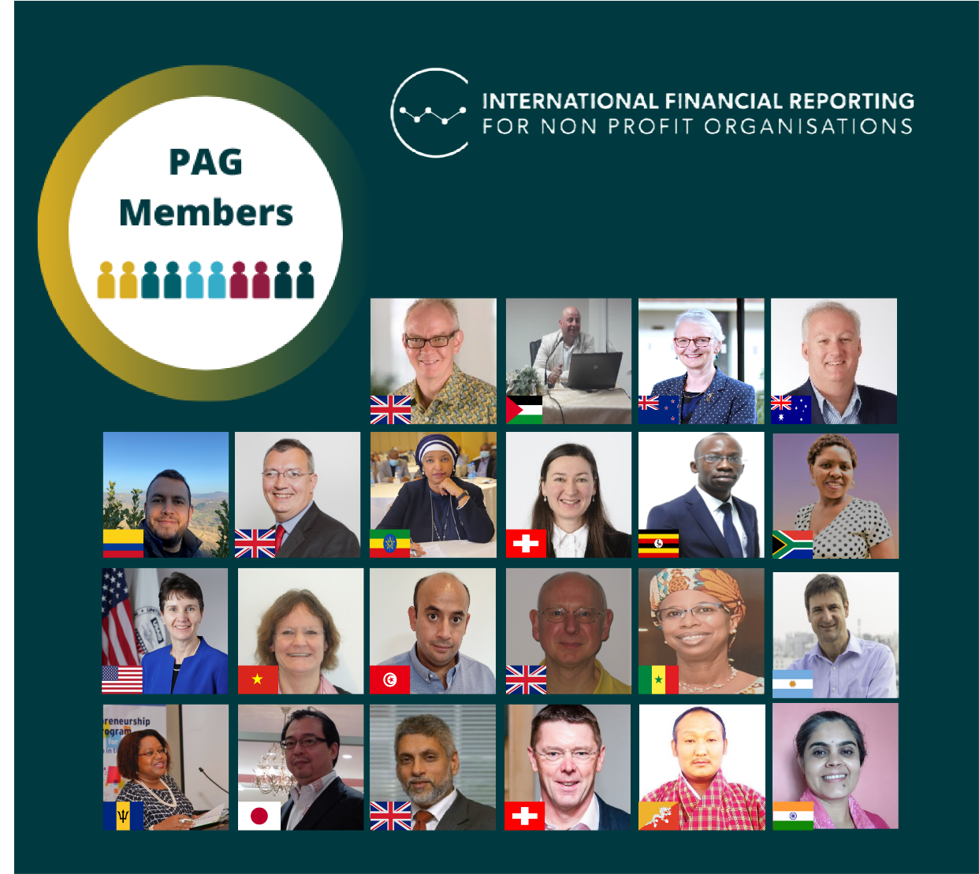
Advisory Groups
Technical (TAG)
Practitioner (PAG)
Standard setters
NPOs, auditors, funders & academics

Slide 16
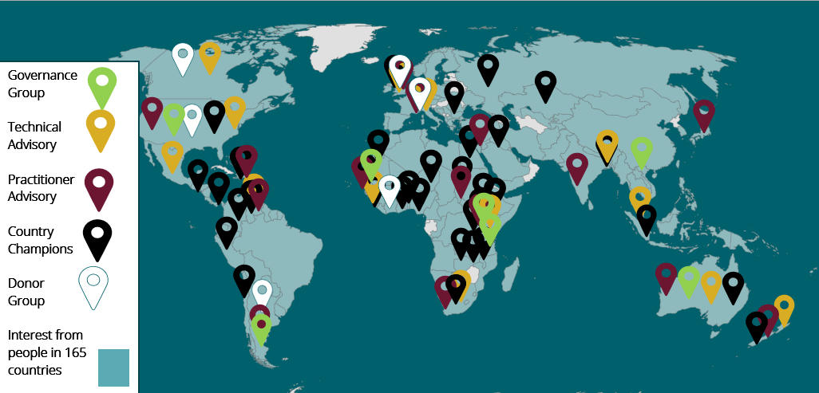
Engagement around the world
14,000+
Newsletter subscribers
+ LinkedIn & YouTube

Slide 17
Development process
Phase 1
Consultation Paper – structured stakeholder input, January 2021
Phase 2
3 x Exposure Drafts - draft guidance for public comment, 2022, 2023, 2024
Phase 3
Final Guidance – ready for adoption, 2025
1
Training and transition following adoption– 2025 onwards
☑
Technical rigour
☑
Stakeholder engagement
Equivalent process to other international accounting standards

Slide 18
INPAG ED1
Description of NPOs /Reporting entity
Framework for INPAG
concepts and pervasive principles
Launched on 21 November 22
Closed for responses on 31 March 2023
Youtube playlist
www.ifr4npo.org/ed1
Financial statements presentation
including fund accounting
Narrative reporting
analysis and performance

Slide 19
INPAG ED2
Revenue from
grants and donations
Expenses on grants and donations
Launched on 26 September 2023
Closed for responses on 31 March 2024
Youtube playlist
www.ifr4npo.org/ed2
Inventory (especially for onward distribution)
Foreign currency translation

Slide 20
INPAG ED3
Classification of expenses
Fundraising costs
Launched on 28 May 2024
Closed for responses on 16 Sep 2024
www.ifr4npo.org/ed3
Fund accounting
Practice Guide for Donor Reporting

Slide 21
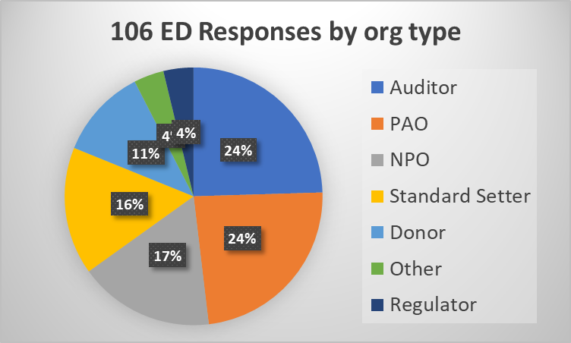
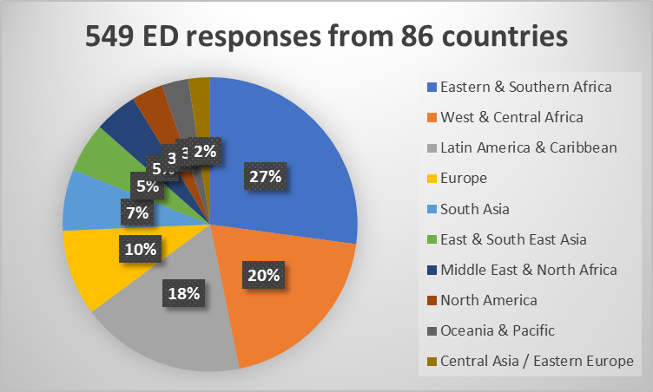
Exposure Draft responses
Geographic diversity
Stakeholder representation
Quantity & Quality
3 EDs 2022, 2023 & 2024
549 responses
179 written comment letters (106 organisations + 73 individuals)
370 surveys

Slide 22
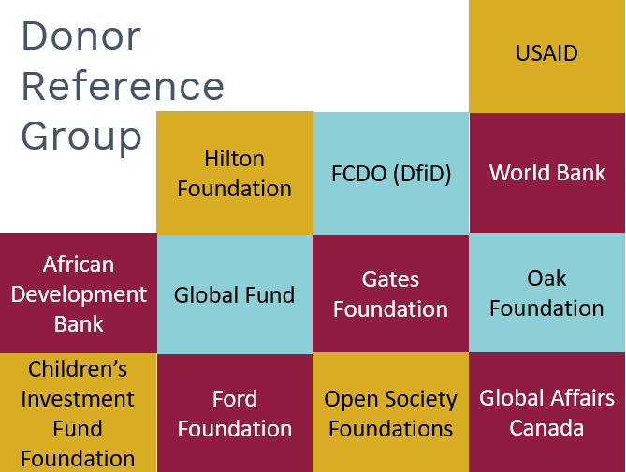
Donor engagement
Funding from
Input from
Donor statement of support

Slide 23
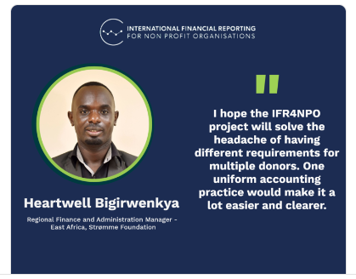

Slide 24
IFR4NPO - high level goals
Improve quality and reliability of financial reports
Reduce burden of multiple formats
Win win win!

Slide 25
Current story
General-purpose financial reports
Special-purpose
financial reports
Bankers
Suppliers
Regulator
Funder 1
Partners
Tax authority
Funder 2
Employees
Potential funders
Board members
Funder 3
Grantees
Civil society
Service users
Notes:
Dotted line on the left shows GPFS are of limited usefulness to most stakeholders
On the RHS we can see different formats for each donor – these are called special purpose financial reports. They meet the needs of one user only.
No link between them, even tho they are supposed to come from same accounting system

Slide 26
Future with INPAG
General-purpose financial reports
Special-purpose
financial reports
Bankers
Suppliers
Regulator
Funder 1
Partners
Tax authority
Funder 2
Employees
Potential funders
Board members
Funder 3
Grantees
Civil society
Service users
Notes:
GPFS more useful to range of stakeholders (power shift and impact!)
Single format for donor reporting (reduced burden on NPOs)
Bridge / link between them (increased assurance for Funders)

Slide 27
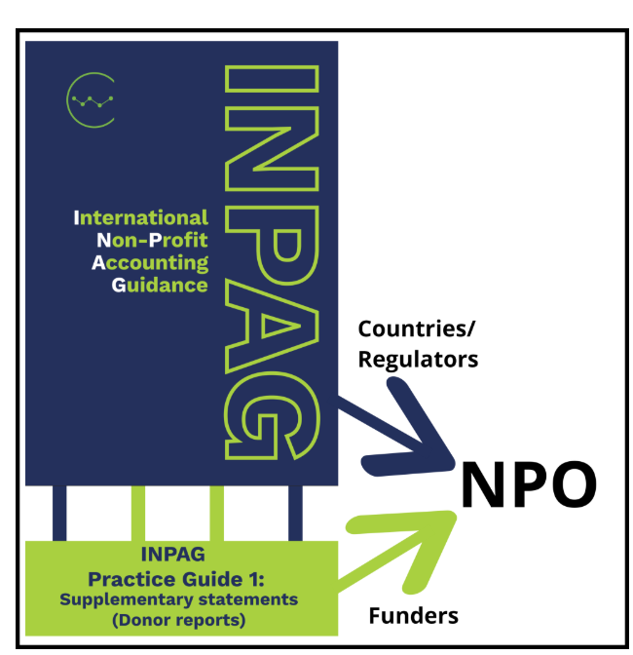
Who mandates?

Slide 28
How can harmonization bring benefits?
To Funders
To NPOs
Stronger assurance on grant reports – due to linkage and reconciliation to main accounts
Easier due diligence – more relevant information provided in general purpose audited accounts
Improved transparency – on both restricted and unrestricted funding
More consistency – making it easier to train desk officers to understand financial reports
Reduced burden – single format for all funders and country offices, less duplication, streamlined and efficient
Demonstrate capacity – local NPOs on same footing to attract funds
Better information – about financial sustainability, overhead recovery, exchange losses etc
Relevant support – training and software providers can focus and improve products to meet sector needs

Slide 29
What can you do?
Calls to action
Demonstrate your support
Join the movement - subscribe for email updates
ICAN as country champion, convene a National Working Group
Learn more about INPAG
Promote adoption of INPAG in Nigeria

Slide 30
Primary audience for INPAG
Tier 1 NPOs – Full IFRS or equivalent
Tier 2 NPOs - INPAG
Tier 3 NPOs – cash based likely to be sufficient
Very small local CBOs not primary audience

